Slide 1
Virtual Keyboard Architecture and Qt Applications

Slide 2
Agenda
Overview
Input method architecture
Input method API in Qt.
Virtual keyboard in Qt.

Slide 3
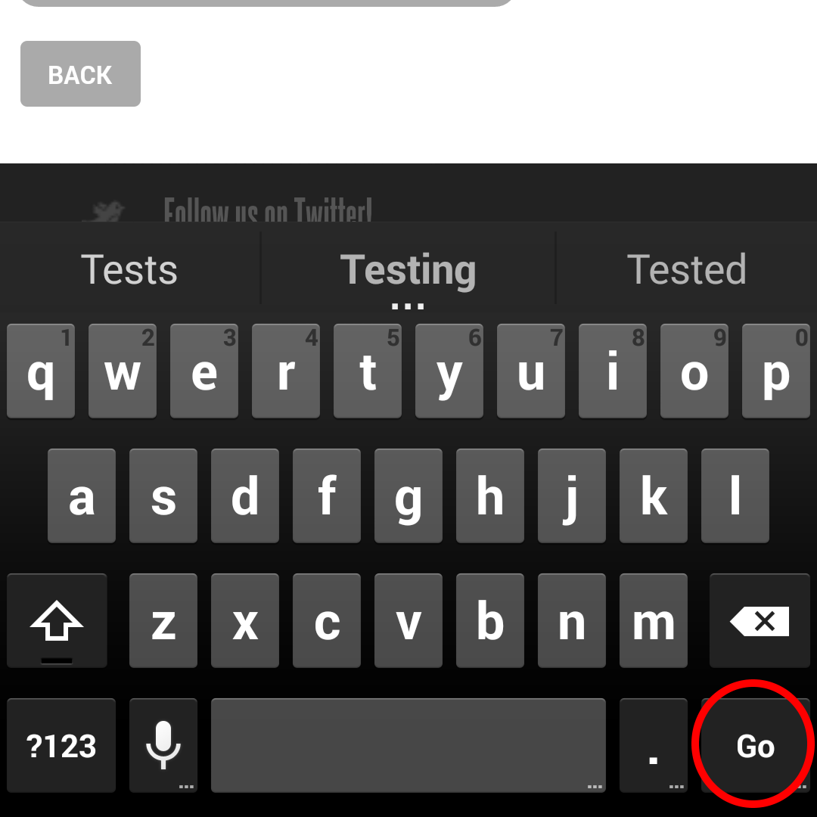
1. Overview

Slide 4
Input method editor
Input method (IME) is an operating system component or program that allows any data, such as keyboard strokes or mouse movements, to received as input.
On platforms with touch-based input device such as mobile phones, cars…, an IME also plays a role to type text that a simple on-screen keyboard cannot type directly.

Slide 5
Virtual keyboard (on-screen)
is an input device that emulates the functionality of a real computer keyboard. The keyboard software draws a keyboard on the screen that allows the user tap key locations to enter characters.
Allowing a person to type in their own language on foreign keyboards – such as when traveling abroad or living in another country.
Enabling a more accessible typing experience by allowing typing by on – screen clicks.
Proving a fast, simple way to switch between different character sets and/or alphabets.

Slide 6
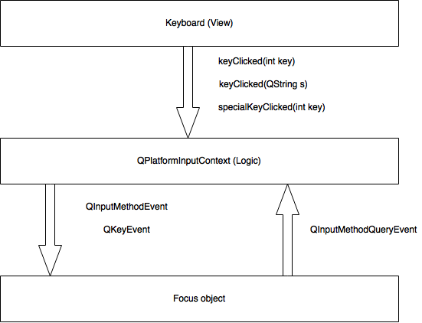
2. Input method architecture

Slide 7
Input method architecture
Keyboard (view): shows the keyboard buttons, reacts to user interaction and delivers the synthesized QKeyEvents of application’s event loop.
QPlatformInputContext (logic - IME): has got the raw input data now and can forward them to actual platform specific input method backend.

Slide 8
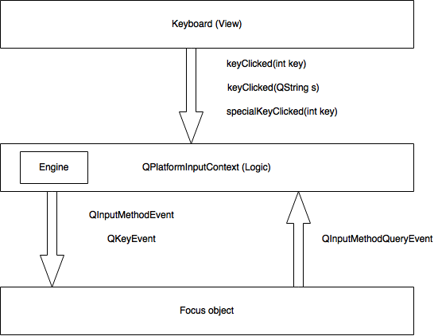
Vietnamese Input Method

Slide 9
Conversion engines (composer)
Is a context-free parser that composes non-ASCII characters (including phonetic characters) from keystrokes.
Methods of inputting Vietnamese: for Vietnamese tones as well as Vietnamese special characters.
TELEX: use alphabet keys only.
VNI: use numeric keys.

Slide 10
3. Input Method API in Qt
QInputMethod:
Access virtual keyboard from application.
QPlatformInputContext:
Logic component, return combined text, transform text...
QInputMethodQueryEvent:
Send information from application to virtual keyboard .
QInputMethodEvent/ QKeyEvent:
Send input events from virtual keyboard to application.

Slide 11
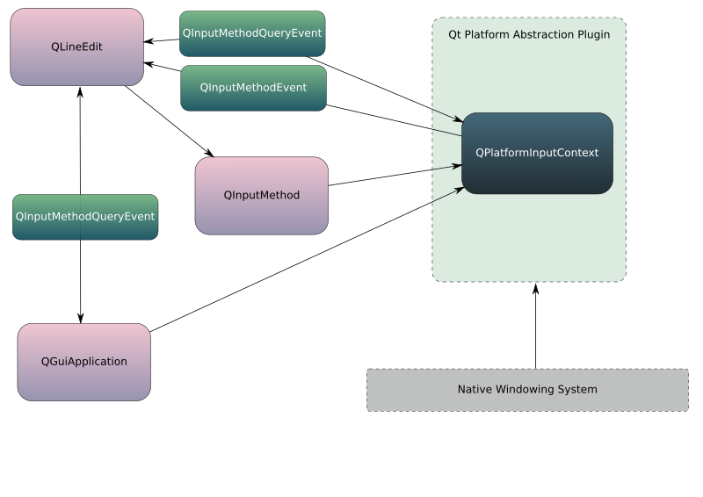
Input Method API in Qt

Slide 12
QPlatformInputContext (logic)
QPlatformInputContext provides an interface the actual input methods can derive from by reimplementing methods.
An input method is responsible for inputting complex text that cannot be inputted via simple map. It converts a sequence of input events (typically key events) into a text string through the input method specific converting process.
Perform grammar and semantic analysis.

Slide 13
QPlatformInputContext (logic)
Two kinds of QPlatformInputContext for virual keyboard:
Native provided by platform: Android, IOS, Windows…
Custom via QPlatformInputContextFactory.

Slide 14
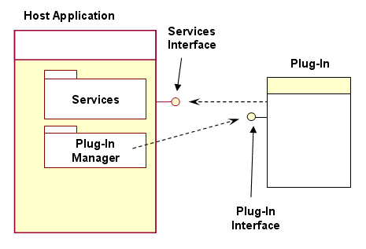
Plug-in Architecture

Slide 15
Plug-in Architecture
A plug-in is a piece of software that extends or changes the behavior or interface of an existing, compiled application:
QPlatformInputContextPlugin = Plug-in Manager.
QPlatformInputContext = Plug-in.
Focus Object = Service Interfaces.

Slide 16
QPlatformInputContextFactory (plug-in)
Subclass is a plug-in manager, by setting the environment variable QT_IM_MODULE to the identifier of the input method.
Supported platform:
Eglfs
Directfb
Xcb
Cocoa
Mirclient
Wayland
Windows

Slide 17
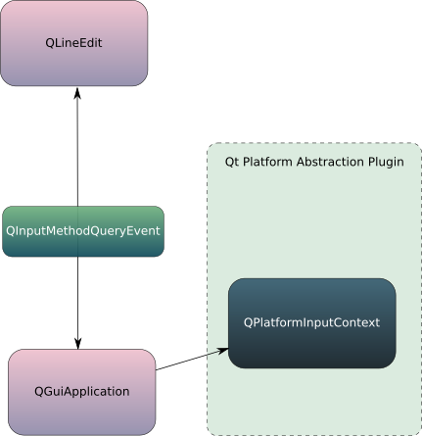
QPlatformInputContextFactory

Slide 18
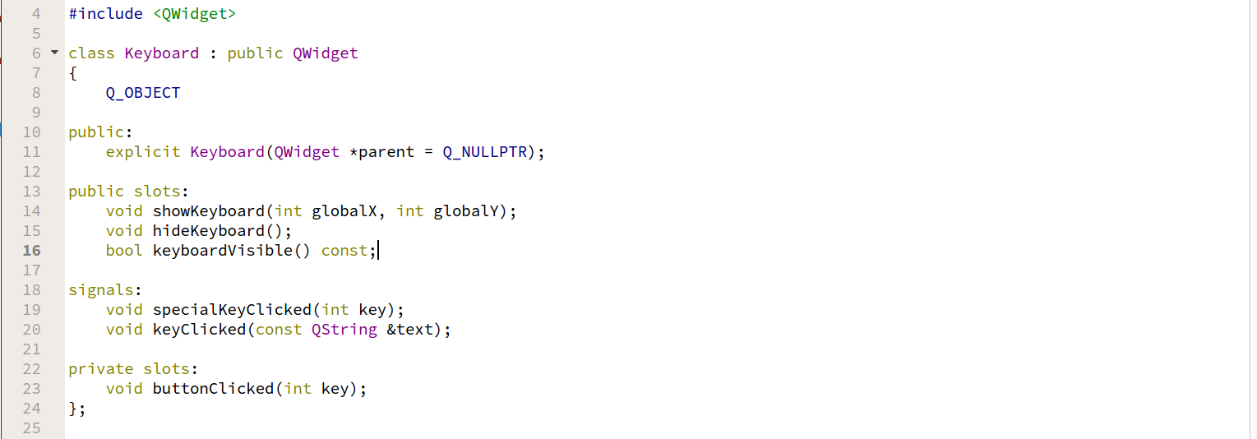
Keyboard (View)

Slide 19
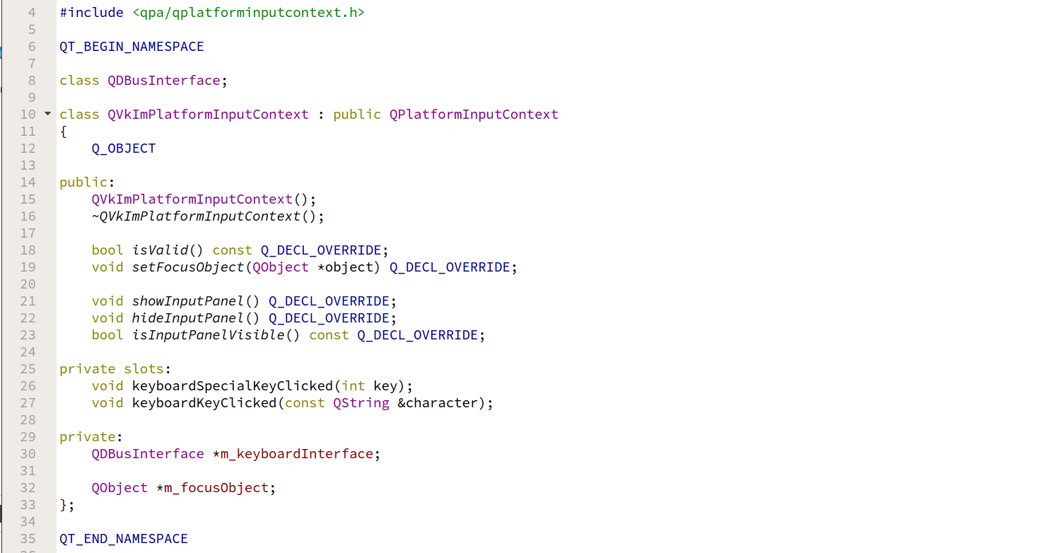
QPlatformInputContext (Logic)

Slide 20
QInputMethodEvent/ QKeyEvent
QKeyEvent: sent to the widget with keyboard input focus when keys are pressed or released.
QInputMethodEvent: sent to widgets when an input method is used to enter text into a widget. Input methods are widely used to enter text for languages with non-Latin alphabets.

Slide 21
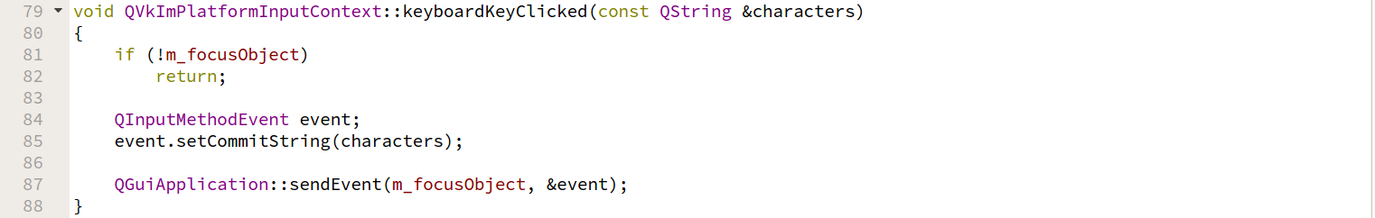
QInputMethodEvent

Slide 22
Available virtual keyboard for Qt
Multi language support.
Support for text correct.

Slide 23
References
https://www.kdab.com/qt-input-method-virtual-keyboard/
https://www.kdab.com/qt-input-method-depth/
https://www.youtube.com/watch?v=68wlCEW4YaY
https://www.chromium.org/chromium-os/chromiumos-design-docs/text-input
http://www.w3.org/TR/ime-api/

